Slide 1


Week 01: Introduction to Research
United States International University
MIS 6220 RESEARCH METHODS
_{BY}
Prof. Jimmy K.N.Macharia,
Associate Professor of Information Systems &Technology, and
Dean, School of Science & Technology,
_{kmacharia@usiu.ac.ke}

Slide 2
Overview
After completing Lesson 1, you should be able to:
Describe what is research is and how it is defined.
Distinguish between applied and basic research, giving examples, and discussing why they would fall into one or the other of the two categories.
Describe Research Continuum
Distinguish Types of Research
Types of Variables

Slide 3
Exercise 1.1: What is Research ?
Write down your understanding of the meaning of “Research
………………………………………………………….............................................................................................................................................................................................................................................................................................................................................................................................................
Give examples of what media call “research” but is not ……………………………………………………………………………………………………………………………………………………………………………………………….

Slide 4
1.2 What is Research ?
“the process of finding solutions to a problem after a thorough study and analysis of the situational factors” (Sekeran 2014:2)
When you say that you are undertaking a research study to find answers to a question, you are implying that the process;
1. is being undertaken within a framework of a set of philosophies ( approaches);
2. uses procedures, methods and techniques that have been tested for their validity and reliability;
3. is designed to be unbiased and objective .

Slide 5
1.3 What is Research ?
Philosophies
means approaches e.g. qualitative, quantitative and the academic discipline in which you have been trained.
Validity
means that correct procedures have been applied to find answers to a question.
Reliability
refers to the quality of a measurement procedure that provides repeatability and accuracy.
Unbiased and objective
means that you have taken each step in an unbiased manner and drawn each conclusion to the best of your ability and without introducing your own vested interest. (Bias is a deliberate attempt to either conceal or highlight something)

Slide 6
1.4 What is Research ? NOTE
Adherence to the three criteria mentioned above enables the process to be called ‘research’.
However,
the degree to which these criteria are expected to be fulfilled varies from discipline to discipline
and so the meaning of ‘research’ differs from one academic discipline to another.
Research is
a structured enquiry that utilizes acceptable scientific methodology to solve problems and create new knowledge that is generally applicable. Scientific methods consist of systematic observation, classification and interpretation of data

Slide 7
1.5 What is Research ? Dictionaries Perspective..
“a careful investigation or inquiry specially through search for new facts in any branch of knowledge.” The Advanced Learner’s Dictionary of Current English”
“the manipulation of things, concepts or symbols for the purpose of generalising to extend, correct or verify knowledge, whether that knowledge aids in construction of theory or in the practice of an art. (Encyclopaedia of Social Sciences)

Slide 8
1.6 What is Research ? Technical meaning
Research is an academic activity and as such the term should be used in a technical sense. According to Clifford Woody research comprises
defining and redefining problems,
formulating hypothesis or suggested solutions;
collecting, organising and evaluating data;
making deductions and reaching conclusions;
and at last carefully testing the conclusions to determine whether they fit the formulated hypothesis. (Kothari, 2004:1)
“Research' refers to the systematic method consisting of enunciating the problem, formulating a hypothesis, collecting the facts or data, analysing the facts and reaching certain conclusions either in the form of solutions(s) towards the concerned problem or in certain generalisations for some theoretical formulation” (Kothari, 2004:2)

Slide 9
1.7 What is NOT Research?
Walliman (2005) argues that many of the everyday uses in Radio, TV, Newspapers of the term ‘research’ are not research in the true meaning of the word.
As part of this, he highlights ways in which the term is used wrongly:
just collecting facts or information with no clear purpose;
reassembling and reordering facts or information without interpretation;
as a term to get your product or idea noticed and respected
(Saunders, Lewis and Thornhill,2009:5)

Slide 10

2.1 CHARACTERISTICS OF RESEARCH
Controlled,
Rigorous,
Systematic,
Valid and Verifiable,
Empirical And
Critical.

Slide 11
2.2 CHARACTERISTICS OF RESEARCH
Controlled,
in real life there are many factors that affect an outcome. control implies that, in exploring causality in relation to two variables (factors), you set up your study in a way that minimizes the effects of other factors affecting the relationship
Rigorous,
you must be scrupulous in ensuring that the procedures followed to find answers to questions are relevant, appropriate and justified. Again, the degree of rigor varies markedly between the physical and social sciences and within the social sciences.

Slide 12
2.3 CHARACTERISTICS OF RESEARCH
Systematic
this implies that the procedure adopted to undertake an investigation follow a certain logical sequence. The different steps cannot be taken in a haphazard way. Some procedures must follow others.
Valid and Verifiable,
this concept implies that whatever you conclude on the basis of your findings is correct and can be verified by you and others

Slide 13
2.4 CHARACTERISTICS OF RESEARCH
Empirical
this means that any conclusion drawn are based upon hard evidence gathered from information collected from real life experiences or observations.
Critical.
critical scrutiny of the procedures used and the methods employed is crucial to a research enquiry. The process of investigation must be foolproof and free from drawbacks. The process adopted and the procedures used must be able to withstand critical scrutiny. For a process to be called research, it is imperative that it has the above characteristics.

Slide 14
3.1 TYPES OF RESEARCH..
‘Research can be classified from three perspectives: 1. application of research study 2. objectives in undertaking the research 3. inquiry mode employed
4. type of information thought

Slide 15
3.1 TYPES OF RESEARCH: Application:
From the point of view of application, there are two broad categories of research:
pure research and
applied research
Pure research
involves developing and testing theories and hypotheses that are intellectually challenging to the researcher but may or may not have practical application at the present time or in the future.
The knowledge produced through pure research is sought in order to add to the existing body of research methods.

Slide 16
3.1 TYPES OF RESEARCH: Application:
Applied research
is done to solve specific, practical questions; for policy formulation, administration and understanding of a phenomenon.
It can be exploratory, but is usually descriptive.
It is almost always done on the basis of basic research.
Applied research can be carried out by academic or industrial institutions.
Often, an academic institution such as a university will have a specific applied research program funded by an industrial partner interested in that program

Slide 17
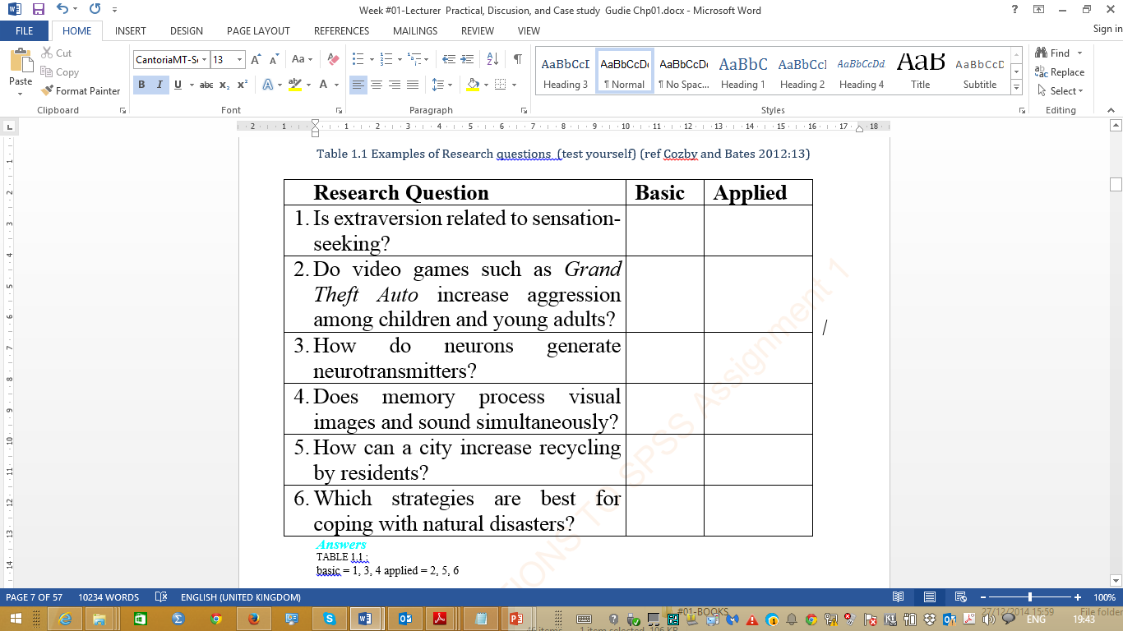
3.1 TYPES OF RESEARCH: Application:
Applied research
is done to solve specific, practical questions; for policy formulation, administration and understanding of a phenomenon.
It can be exploratory, but is usually descriptive.
It is almost always done on the basis of basic research.
Applied research can be carried out by academic or industrial institutions.
Often, an academic institution such as a university will have a specific applied research program funded by an industrial partner interested in that program

Slide 18
3.1 TYPES OF RESEARCH: Objectives:
From the viewpoint of objectives, a research can be classified as:
-descriptive
-correlational
-explanatory
-exploratory

Slide 19
3.1 TYPES OF RESEARCH: Objectives:
Descriptive research
attempts to describe systematically a situation, problem, phenomenon, service or programme, or provides information about , say, living condition of a community, or describes attitudes towards an issue.
Correlational research
attempts to discover or establish the existence of a relationship/ interdependence between two or more aspects of a situation.

Slide 20
3.1 TYPES OF RESEARCH: Objectives:
Explanatory research
attempts to clarify why and how there is a relationship between two or more aspects of a situation or phenomenon.
Exploratory research
is undertaken to explore an area where little is known or to investigate the possibilities of undertaking a particular research study (feasibility study / pilot study).
In practice most studies are a combination of the first three categories

Slide 21
3.1 TYPES OF RESEARCH: Inquiry Mode: :
Inquiry Mode: From the process adopted to find answer to research questions – the two approaches are:
Structured approach
Unstructured approach

Slide 22
3.1 TYPES OF RESEARCH: Inquiry Mode: :
Structured approach:
The structured approach to inquiry is usually classified as quantitative research.
Here everything that forms the research process- objectives, design, sample, and the questions that you plan to ask of respondents- is predetermined. It is more appropriate to determine the extent of a problem, issue or phenomenon by quantifying the variation. e.g. how many people have a particular problem? How many people hold a particular attitude?

Slide 23
3.1 TYPES OF RESEARCH: Inquiry Mode: :
Unstructured approach:
The unstructured approach to inquiry is usually classified as qualitative research.
This approach allows flexibility in all aspects of the research process
Note:
It is more appropriate to explore the nature of a problem, issue or phenomenon without quantifying it.
Main objective is to describe the variation in a Phenomenon, situation or attitude

Slide 24
3.1 TYPES OF RESEARCH: Type of information
Quantitative research
research is based on the measurement of quantity or amount.
applicable to phenomena that can be expressed in terms of quantity.
Qualitative research
concerned with qualitative phenomenon, i.e., phenomena relating to or involving quality or kind.
For instance,
when we are interested in investigating the reasons for human behaviour (i.e., why people think or do certain things),eg why women cheat
‘Motivation Research’, is an important type of qualitative research.

Slide 25
3.1 TYPES OF RESEARCH: Type of information
Purpose of Qualitative Research
aims at discovering the underlying motives and desires, using in depth interviews for the purpose.
Other techniques of such research are
word association tests,
sentence completion tests,
story completion tests and
similar other projective techniques.
Attitude or opinion research i.e.,
research designed to find out how people feel or what they think about a particular subject or institution is also qualitative research
NOTE
apply qualitative research in practice is relatively a difficult job and therefore, while doing such research, one should seek guidance from experimental psychologists.

Slide 26
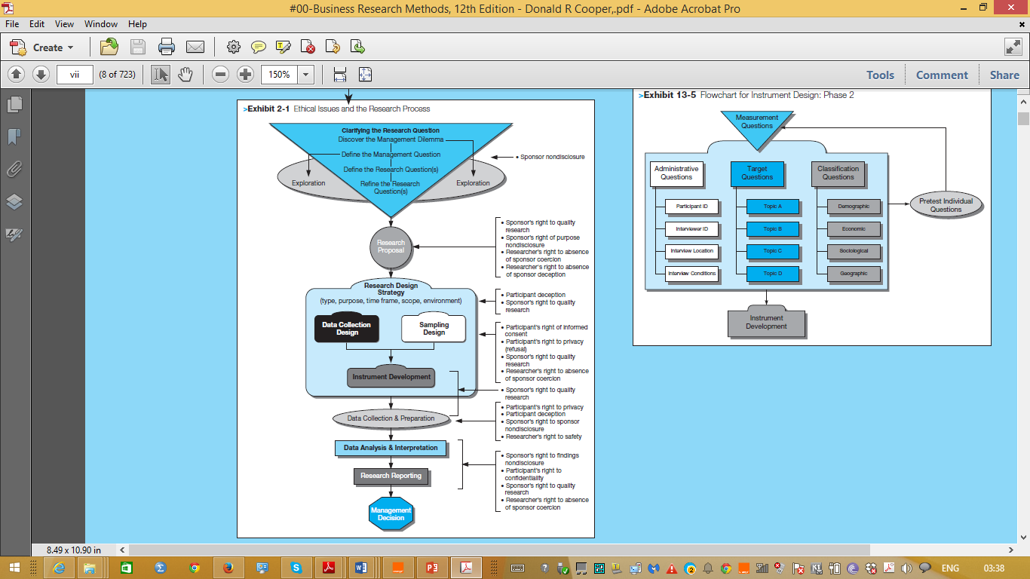
1.6
Cooper & Schindler, 2014:viii)

Slide 27
4.1 THE RESEARCH PROCESS
The research process is similar to undertaking a journey. For a research journey there are two important decisions to make-
What you want to find out about or what research questions (problems) you want to find answers to;
How to go about finding their answers.

Slide 28
4.1 THE RESEARCH PROCESS
This is where your knowledge base of research methodology plays a crucial role.
Steps in Research Process
Formulating the Research Problem
Extensive Literature Review
Developing the objectives
Preparing the Research Design including Sample Desig
Collecting the Data
Analysis of Data
Generalization and Interpretation
Preparation of the Report or Presentation of Results-Formal write ups of conclusions reached.

Slide 29
Step1. Formulating the research problem:
It is the first and most crucial step in the research process
Main function is to decide what you want to find out about.
The way you formulate a problem determines almost every step that follows
Sources of research problems: Research in social sciences revolves around four Ps:
People-
a group of individuals
Problems-
examine the existence of certain issues or problems relating to their lives; to ascertain attitude of a group of people towards an issue
Programs-
to evaluate the effectiveness of an intervention
Phenomena-
to establish the existence of a regularity.
In practice most research studies are based upon at least a combination of two

Slide 30
Step1. Formulating the research problem:
Every research study has two aspects:
Study population-
People: individuals, organizations, groups, communities ( they provide you with the information or you collect information about them)
Subject area-
Problems:
issues, situations, associations, needs, profiles
Program :
content, structure, outcomes, attributes, satisfactions, consumers, Service providers, etc.
Phenomenon:
cause-and-effect relationships, the study of a phenomenon itself
(Information that you need to collect to find answers to your research questions)

Slide 31
Step1. Formulating the research problem:
Considerations in selecting a research problem: 1.Interest:
a research endeavor is usually time consuming, and involves hard work and possibly unforeseen problems. One should select topic of great interest to sustain the required motivation.
Magnitude:
It is extremely important to select a topic that you can manage within the time and resources at your disposal. Narrow the topic down to something manageable, specific and clear.
Measurement of concepts:
Make sure that you are clear about the indicators and measurement of concepts (if used) in your study.

Slide 32
Step1. Formulating the research problem:
Considerations in selecting a research problem: 4. Level of expertise:
Make sure that you have adequate level of expertise for the task you are proposing since you need to do the work yourself
5. Relevance:
Ensure that your study adds to the existing body of knowledge, bridges current gaps and is useful in policy formulation. This will help you to sustain interest in the study.
6. Availability of data:
Before finalizing the topic, make sure that data are available.
7. Ethical issues:
How ethical issues can affect the study population and how ethical problems can be overcome should be thoroughly examined at the problem formulating stag

Slide 33
Step1. Formulating the research problem:
Steps in formulation of a research problem
Working through these steps presupposes a reasonable level of knowledge in the broad subject area within which the study is to be undertaken.
Without such knowledge it is difficult to clearly and adequately ‘dissect’ a subject area

Slide 34
Step1. Formulating the research problem:
Steps in formulation of a research problem
Step 1 Identify a broad field or subject area of interest to you. Step 2 Dissect the broad area into sub areas. Step 3 Select what is of most interest to you. Step 4 Raise research questions. Step 5 Formulate objectives. Step 6 Assess your objectives. Step 7 Double check.

Slide 35
5. Types of variables :
Independent Variable = this variable is the ‘cause
can be manipulated or allowed to vary
also known as the predictor variable
Dependent Variable = this variable is the ‘effect’
should only vary in response to the IV
also known as the criterion variable
Law of the single variable:
there will always be uncontrollable influences
Extraneous Variables = must be controlled to isolate the effect of the IV on the DV
Confounding Variables = extraneous variables which have co-varied with the IV

Slide 36
6.1 What is scientific research?
Generalizable –
we can apply the results to something other than the patients in the study (unlike the television research).
Empirically verifiable,
repeatable – we are told how, where and when it was done, so we could check that it had actually been done and repeat it to check that we got the same results (unlike the cat food commercial).
Transparency of decision making –
we know what was done and why.
Builds on the work of others –
the authors refer to earlier research which showed that infections are related to increased risk of preterm delivery and earlier attempts to intervene.
Generates new ideas for testing –
We can ask what features of the programme led to the effect, e.g. treatment of bacterial or fungal infections.

Slide 37
6.2 What is the process of Scientific Research?
Scientific research follows the scientific method:
Start with an idea or theory.
Devise an investigation to test the theory.
Carry out the investigation.
If the results do not support the theory, think of a new theory.

Slide 38
Reference
Sekaran, U., & Bougie, R. (2014). Research Methods for Business: A Skill-Building Approach, 6th Edition.
Saunders, M., Lewis, P., & Thornhill, A. (2009). Research Methods for Business Students (5th ed.). Tokyo: Prentice Hall.
Cooper, D. R., & Schindler, P. S. (2014). Business Research Methods (12th ed.). Wittenberg: McGraw-Hill Companies.
Kothari C. R. (2011) Research Methodology: Methods and Techniques, 2nd ed. New Age International

Slide 39
Week #01- Exercise due next week
SPSS Assignment 2 (for hand in)
SPSS Assignment 3 (for hand in)
Discussion Questions for Sekaran (2014) Chapter 1
Blackboard –Sekaran Chapter 1 Quiz
Internet activities on Research areas
Readings on Selecting a research Topic

Slide 40


